Slide 1
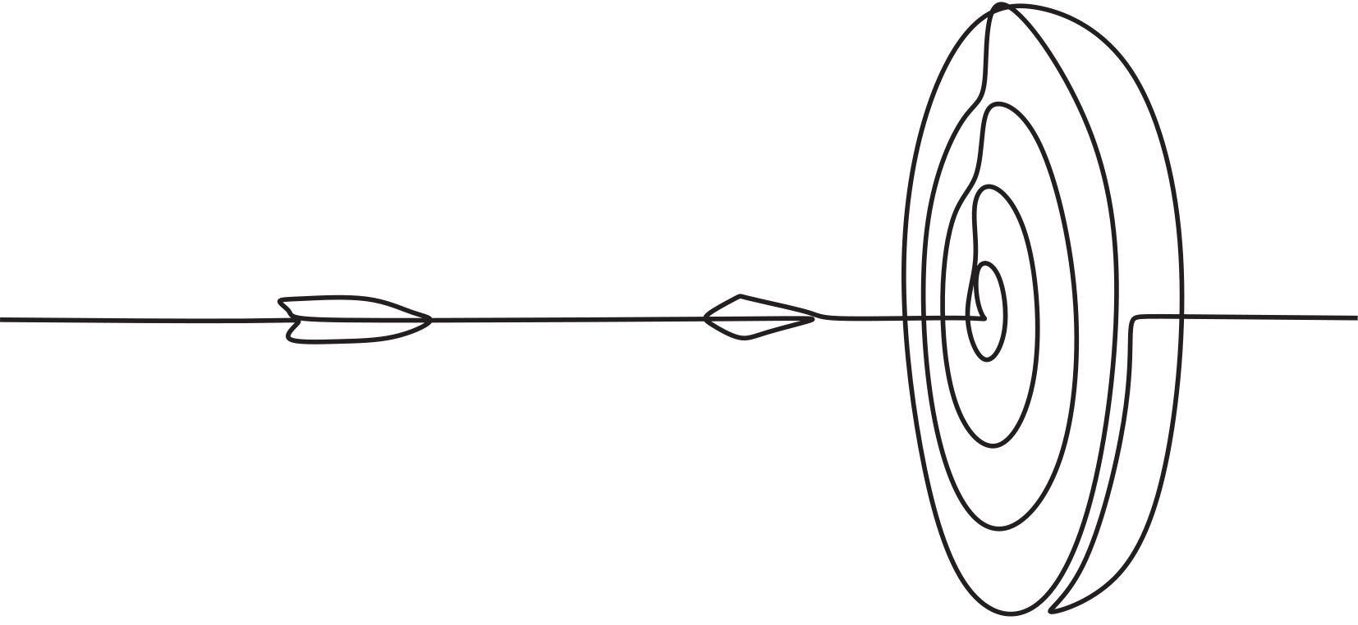
Smart Blind Stick
Mubeena Nazar
S4 MCA
Roll No : 41

Slide 2
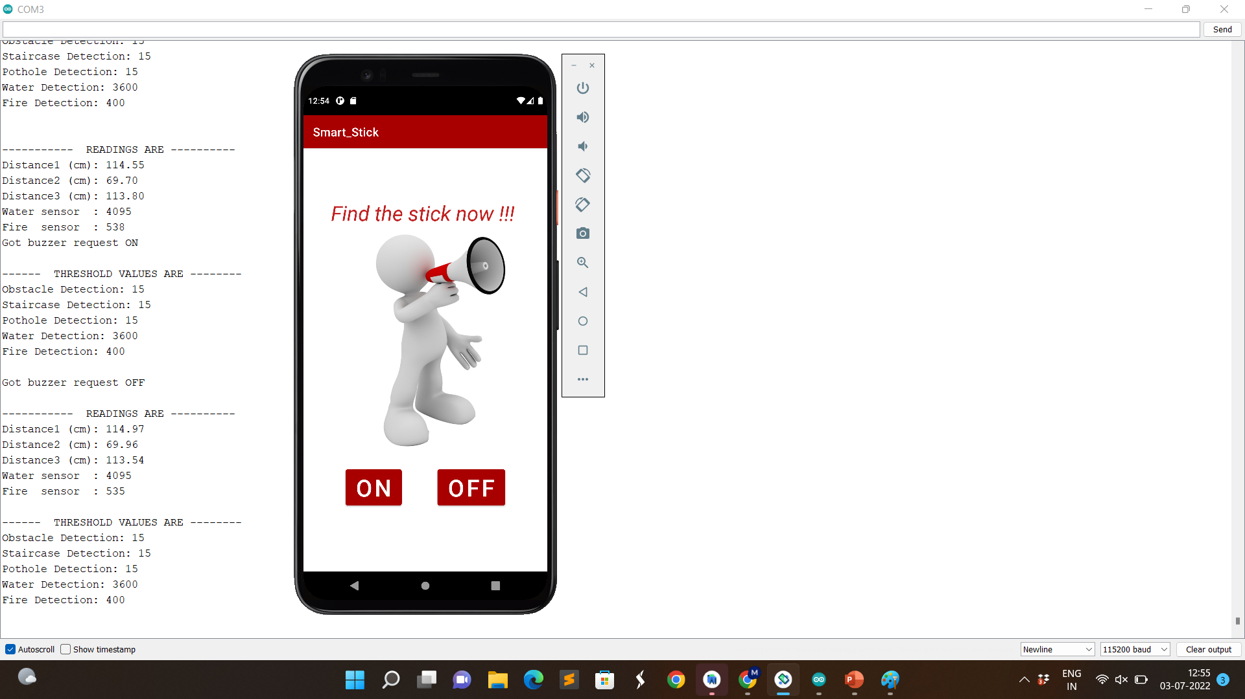

Readings

Slide 3
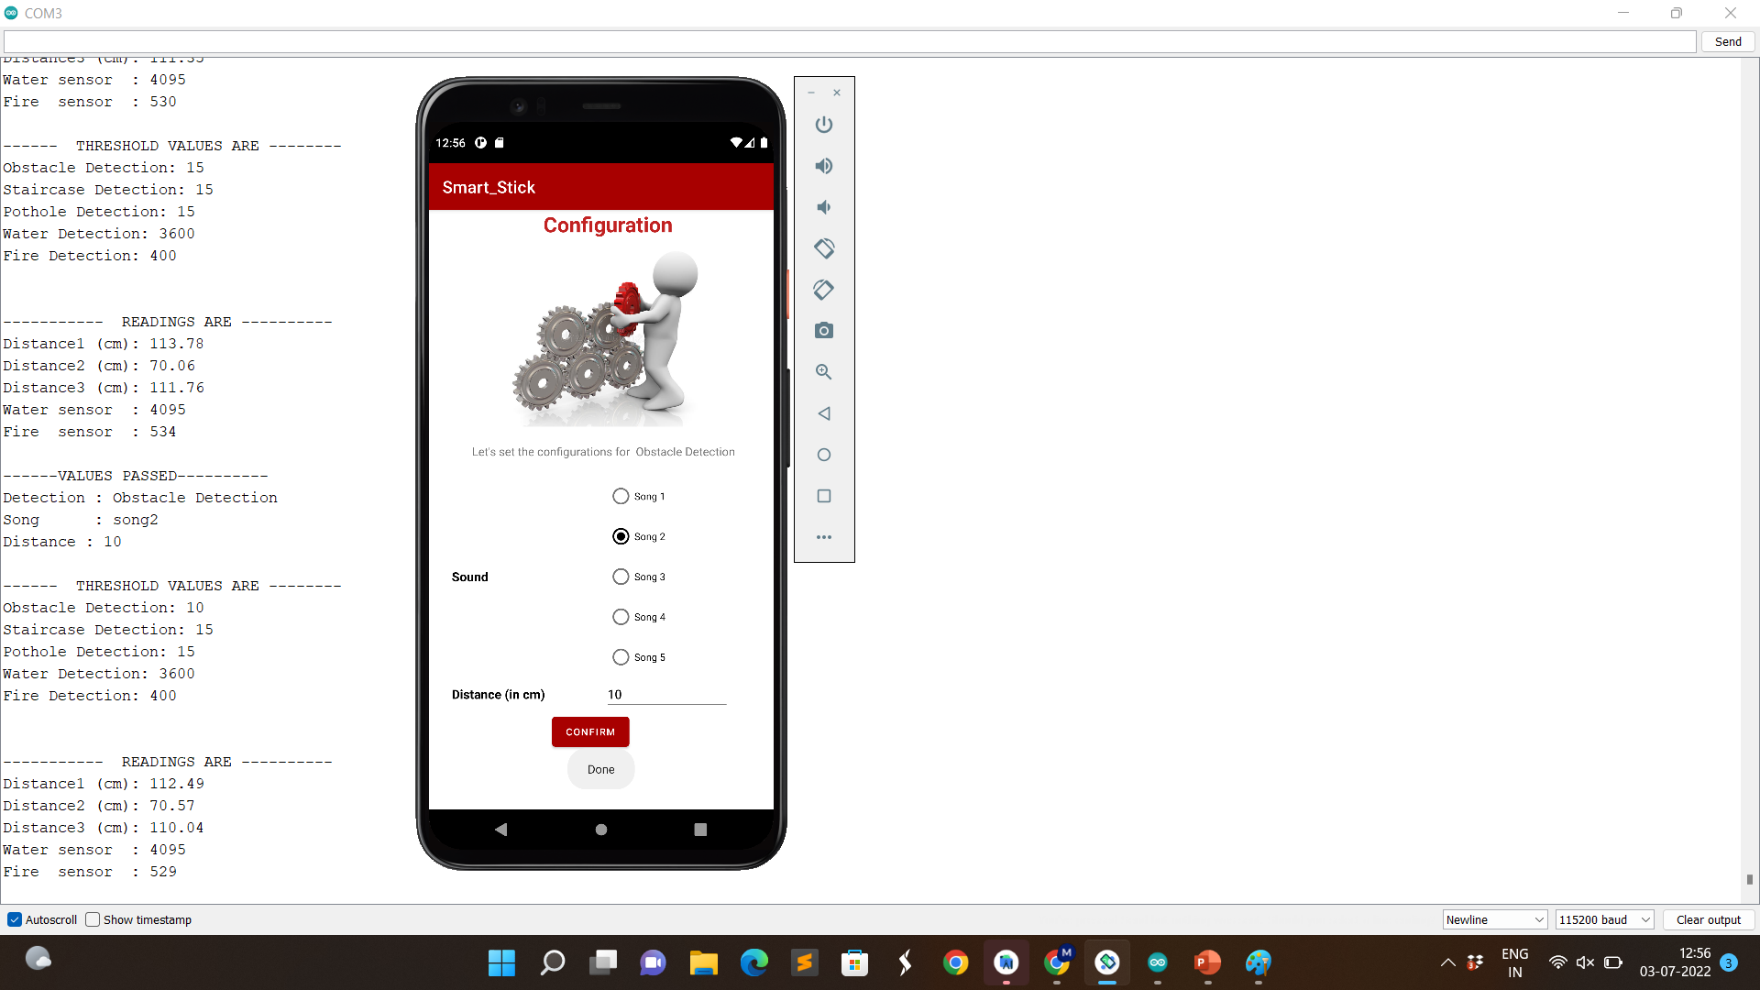
Readings

Slide 4
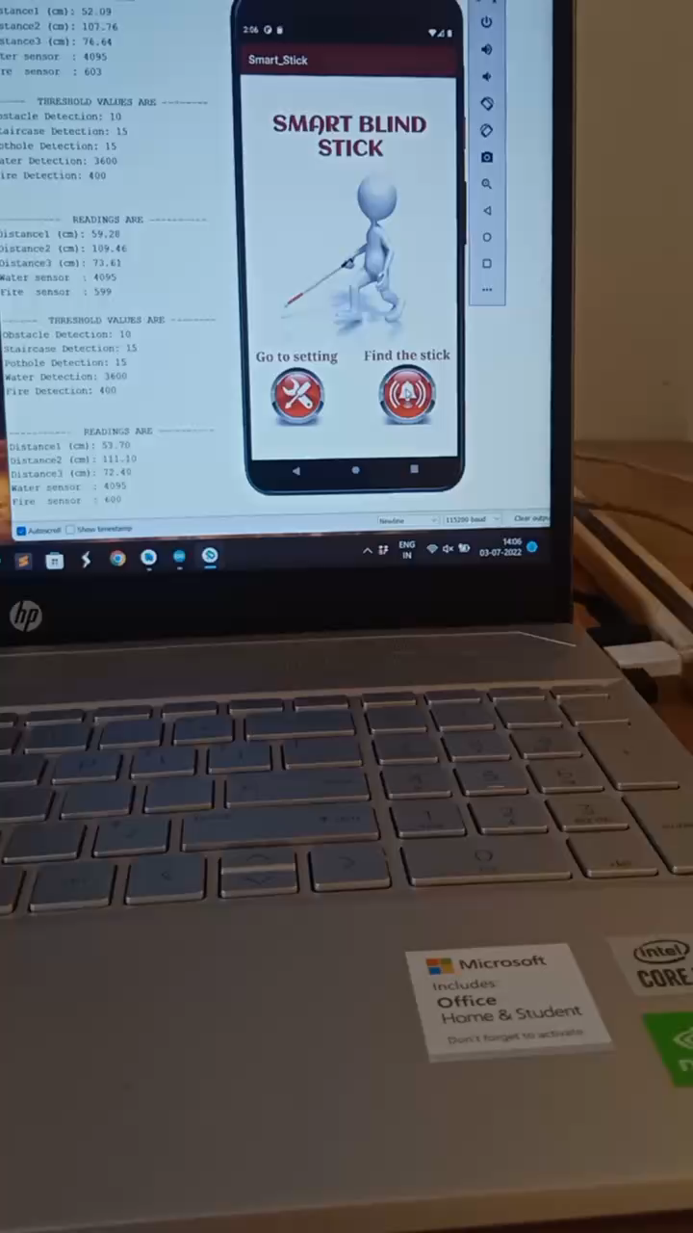

Slide 5


Components | Status
Pothole Detection | Done
Staircase Detection | Done
Obstacle Detection | Done
Water Detection | Done
Fire Detection | Done
Press Button | -
Emergency Contact | -
Android App developed | Done
IoT device configuration settings | Done
GPS
Current Status

Slide 6

CHALLANGES
Sending Location
Connecting GPS module

Slide 7
Topic Finalized
23-4-22
Abstract Submitted
25-04-22
Approval meeting
28-04-22
Literature Survey
30-04-22
Scrum meeting 1
15-05-22
Preparing with base papers
19-05-22
Ordered Equipment
10-05-22
Scrum meeting 2
21-05-22
Detailed study on basic working
23-05-22
Review Meeting 3
24-05-22
Completed detection of each module
27-05-22
Scrum Meeting 3
28-05-22
Developing the android app
30-05-22
Scrum Meeting 4
04-06-22
Integrating the components
08-06-22
Scrum Meeting 5
11-06-22
Developed the complete layout 13-06-22
Scrum meeting 6
18-06-22
Project Review Meeting 1
15-06-22
Scrum meeting 7
18-06-22
Aligned the components
24-06-22
Scrum Meeting 87
28-06-22
Successfully Connected Android app and Iot device
01-07-22
Scrum Meeting 9
02-07-22

Slide 8
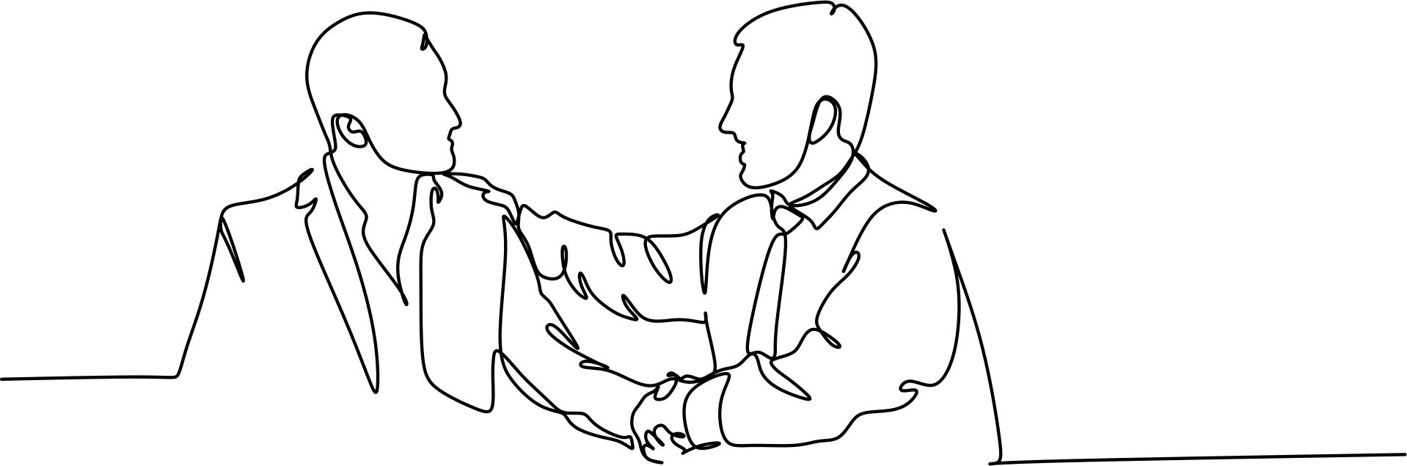
Thank You

